Slide 1

Rockbuster stealth
Company Analysis
Jason Wagner
Data Analyst, BI Department
March 1, 2024

Slide 2
What are we and where are we going?
Rockbuster Stealth is facing stiff competition from streaming services such as Netflix and Amazon Prime.
To compete with this competition, the management team is planning to use its existing movie licenses to launch an online video rental service
What are our rental statistics?
Where is our largest customer volume?
Where do our top customers come from?

Slide 3
RENTAL STATISTICS
Minimal Rental Rate $0.99
Maximum Rental Rate $4.99
Average Rental Rate $2.98
Minimum Rental Duration 3 Days
Maximum Rental Duration 7 Days
Average Rental Duration 5 Days

Slide 4
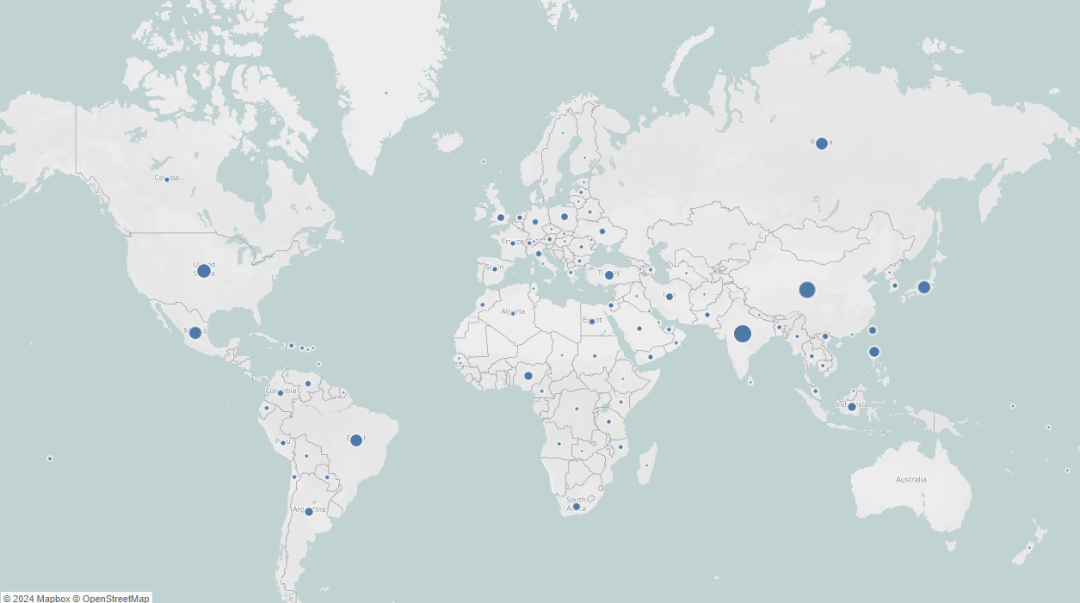
Customer volume
Top Ten Countries
India 60
China 53
U.S. 36
Japan 31
Mexico 30
Brazil 28
Russia 28
Philippines 20
Turkey 15
Indonesia 14

Slide 5
Top 10 cities within the top 10 countries
Aurora, U.S.
Acua, Mexico
Citrus Heights, U.S.
Iwaki, Japan
Ambattur, India
Shanwei, China
So Leopoldo, Brazil
Teboksary, Russia
Tianjin, China
Cianjur, Indonesia

Slide 6
Top 5 customers from the top ten cities
Arlene Harvey Ambattur, India $112
Kyle Spurlock Shanwei, China $110
Marlene Welch Iwaki, Japan $107
Glen Talbert Acua, Mexico $101
Clinton Buford Aurora, U.S. $99

Slide 7
recommendations
Maximize profit by optimizing rental rate and duration
Focus resources to the countries where we are most popular
Initiate Rockbuster Loyalty Rewards Program

Slide 8

Questions?
email: j_wagner@rockbuster.com

